Slide 1

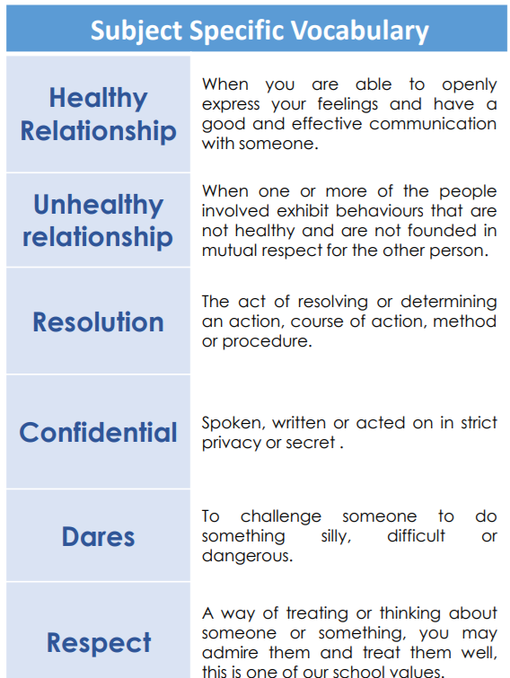
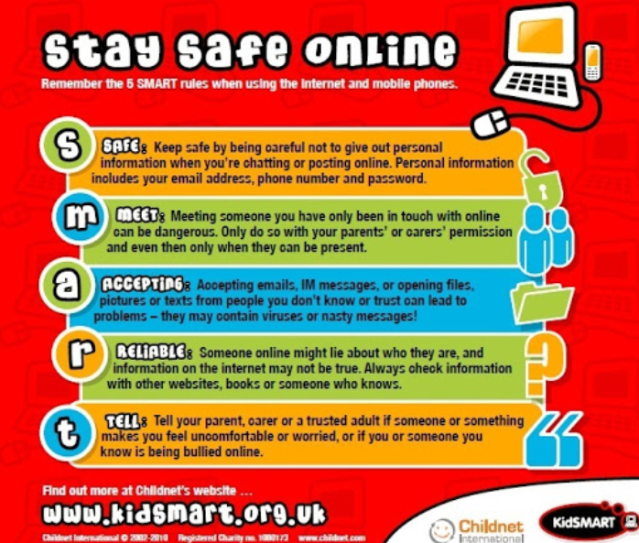



PSHE Relationships Knowledge Organiser
You can have relationships with:
Friends, neighbours, boyfriends, girl friends, parents, teachers, siblings, doctors, dentists, pets and sports coaches and more.

