Slide 1
Internet Safety Workshop
Welcome
to our
Led by Mr K Reynolds

Slide 2
Why are we here?
The Internet has drastically changed the way that children interact with the world. They have access to in-depth knowledge, tools to express their creativity and people from all over the world. Yet along with offering a fascinating, new way to connect with the world, the Internet also offers new risks…
You have all acknowledged this and shown some level of concern by being here.

Slide 3
Introduction
Starting activity:
Take a look at the application emblems on the first sheet in your pack. Can you work out what they all are?
Some children may be more familiar with these so it is important to have a basic idea of what these are and what their capabilities are.

Slide 4
What risks are you aware of already?
Cyberbullying
Exposure to inappropriate material
Online predators
Revealing too much personal information
Leaving an ‘online footprint’

Slide 5
What can we do to minimise the risks?

Slide 6
Set online parameters and parental controls
This simple task can easily protect children from the majority of inappropriate material online.
Most search engines have filtering which can be enabled from the search engines’ settings. In your pack, there are instructions for how to do this with google (and google chrome). If you tend to use a different search engine, then just search how to enable it.
In addition, with most internet service providers (ISPs) such as BT Broadband, Sky, TalkTalk and Virgin Media, you can activate free parental controls at any time.
Finally, many devices such as games consoles, smartphones and tablets have their own parental controls, for example to limit spending or restrict access to apps based on age rating.

Slide 7
Important to remember…
Unfortunately, ‘no filter or parental controls tool is 100% effective, and many of the risks that young people face online are because of their own and other’s behaviour.’ (saferinternet.org, 2017)
More information about filtering (and internet safety):
https://www.saferinternet.org.uk/advice-centre/parents-and-carers/parents-guide-technology
(link within resource pack)

Slide 8
Install anti-virus software
It is important to protect children, yourselves and your devices against harmful viruses which may subject you to inappropriate material. In your resource pack, there is a link to the Top 10 Anti-Virus Software packages (some are free) which can be downloaded onto PCs and computers if your software is not fully up-to-date (mobile technology and consoles should already be equipped with this).
http://www.thetop10antivirus.com/best-free-antivirus

Slide 9
Social media
Question - What is the minimum age should you be to access and have an account on most social media websites/applications?
13
Social media websites/applications, such as Facebook and Twitter, are not designed to ensure the safety of children under 13 (as they should not have accounts).
https://www.youtube.com/watch?v=_o8auwnJtqE

Slide 10
Advice from others regarding social media…
(E-safety expert’s response to a parent concerned about how to manage their child’s activity on social media).

Slide 11
Cyberbullying
It can be:
Anonymous
Not face to face
Repeated aggression
Portable
Viral

Slide 12
Cyberbullying
Department for Eduation (2013), Advice for parents and carers on cyberbullying
(In resource pack)
https://www.gov.uk/government/uploads/system/uploads/attachment_data/file/444865/Advice_for_parents_on_cyberbullying.pdf

Slide 13
Mobiles - Enabling Privacy Settings!
Did you know?
The Android App for Facebook can record sound and video from your phone at any time without your consent – this is something you agree to unknowingly (unless you read the small print) within the Terms of Service.

Slide 14
Tips to ensure ‘safe gaming’
When allowing the use of mobile technology (e.g. iPads, iPhones), use airplane mode on your devices when your child is using them so they can’t make any unapproved purchases or interact with anyone online without your knowledge.
iPhones and other Apple technology uses Apple ID for gaming. It is recommended using only one pass-coded account for all Apple devices you own so that you alone can authorise app purchases and monitor gaming activities.

Slide 15
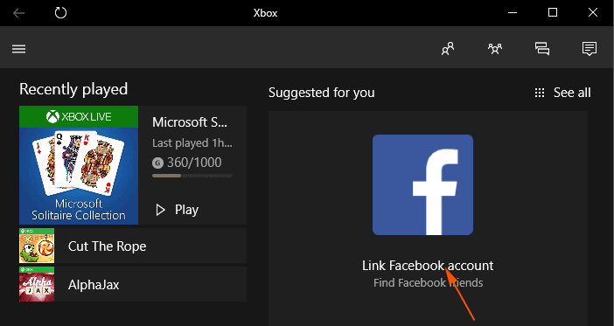
Consoles
Question - What can children do on consoles that may pose a risk to themselves?
The capabilities of consoles are often underestimated.

Slide 16
The incorporation of the internet within consoles like Xbox (360, One) and PS (-3, -4, PSP) can enable children access to games/products which are 18+. These games subject children to concepts which are inappropriate: violence, discrimination, bad language, drugs; sex; violence; gambling; and fear.
When playing these games, children can often become immersed in the behaviour of the game and it may engage in cyberbullying without even realising it. This can also lead to reflected behaviour in real life.
Activate parental controls
(in resource pack)

Slide 17
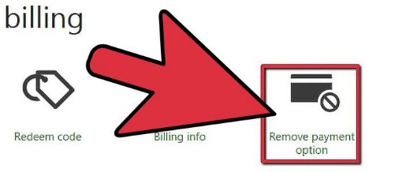
Other tips for online gaming with consoles
If considering buying a console –
Ask questions from the Shopper’s Checklist (in resource pack) to decide whether or not this is appropriate and what precautions to take specifically for that console.
Remove payment options on consoles

Slide 18
Most importantly…
Don’t be afraid to talk to them about it!
Talk to them regularly about internet safety and how to use the internet, social media and mobile technology safely.
- The more that we develop their awareness and understanding of this, then the more conscious they will be of potential dangers. We have to acknowledge that our children will have increasingly more access to the internet as they get older. It’s our responsibility to make sure they know how to use it correctly.

Slide 19
Most importantly…
Establish a set of rules for appropriate use of the internet. UK Safer Internet Centre (2017) recommend that parents and children agree on a ‘set of family rules’ relating to:
time allowed on the internet, consoles, and mobile devices
sites they may use/games that are appropriate
not meeting up with or sharing information with other people
how to behave online
what to do if they feel threatened or bullied (let them know that they can speak to you)

Slide 20
Are there any questions?
Thank you for listening.

